Slide 1

Generation Rx university Conference
Take-Aways – From the HBCU Campus Dialogue *
Tuesday, August 5, 2014
*Convened by the National Council on Patient Information and Education (NCPIE), supported by the Substance Abuse and Mental Health Services Administration (SAMHSA).

Slide 2

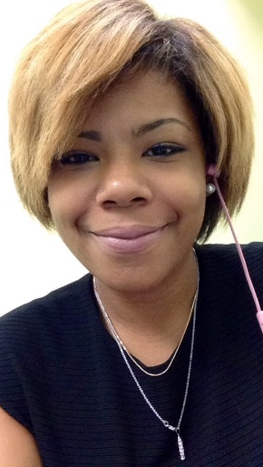
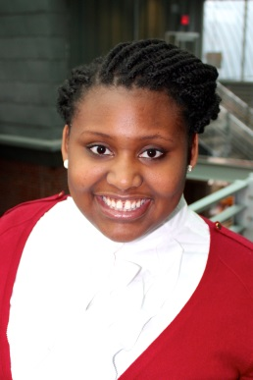
Your Presenters
W. Ray Bullman, Executive Vice-President, National Council on Patient Information and Education
Ayana Evans, Howard University Undergraduate Student
Ashley Washington, Howard University Doctor of Pharmacy Candidate
Notes:
Headshots of Ayana and Ashley

Slide 3
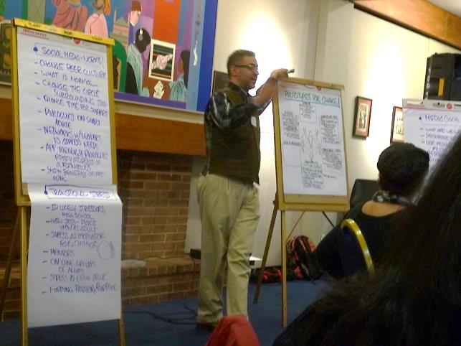
HBCU Campus Dialogue on Prescription Drug Abuse, Treatment & Recovery
GOAL
Two-day meeting to begin understanding how prescription drug abuse impacts students attending HBCUs.
WHY HBCUs?
A research agenda that is screaming for attention.
Little information about the incidence of prescription drug abuse among communities of color and most particularly among students from HBCUs.
Issue is hidden from view.
Notes:
Ray

Slide 4







Hbcu Campus Dialogue
Over 40 attendees converged on the Howard University Campus – Friday-Saturday, March 28-29, 2014, representing
Morgan State University, Baltimore, MD
Trinity University, Washington, DC
University of DC, Washington, DC
University of MD Eastern Shore, Princes Anne, MD
University of MD College Park, MD
Substance Abuse and Mental Health Administration
Area non-profits
Notes:
Ray

Slide 5

About Historically Black colleges and Universities (HBCU)
HBCU’s – a long historical legacy, founded after the Civil War.
Located mostly in the southeastern portion of the US.
Have graduated individuals such as Martin Luther King, W.E.B. DuBois and Booker T. Washington – to name a few.
Today there are 100 HBCUs – representing just 3% of institutions of higher learning.
Approximately 9% of all African American college students attend HBCUs.
HBCUs graduate nearly 20% percent of African Americans who earn undergraduate degrees and more than 50% of African American professionals and public school teachers.
While HBCUs were created to support African American students , today they attract a significant percentage of non-African American students – Asian, Hispanic,-Latino, International and Caucasian.
Notes:
Ashley

Slide 6
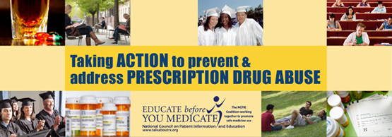
What we know – the big Picture
…nonmedical use of any prescription-type pain relievers, tranquilizers, stimulants or sedatives.
According to the 2012 National Survey on Drug Use and Health (NSDUH):
There were about 2.4 million people, aged 12 or older who used psychotherapeutics nonmedically for the first time within the past year, which averages to about 6,700 initiates per day.
The average age at first nonmedical use of any psychotherapeutics among recent people, aged 12 to 49 was 22.9 years – implying that we need to reach young people before they start using.
The rate of current nonmedical use of psychotherapeutic drugs among young adults aged 18-25 was 5.3% - similar to the rates in 2010 and 2011.
Notes:
Ashley

Slide 7

What we Know – Substance Abuse among
People-of-color
 | Points to…
Substance use rates are generally lower among Black adolescents than national rates for adolescents. HOWEVER, the recent increases in marijuana use and in the nonmedical use of prescription-type drugs among black adolescents highlight the need for treatment programs and prevention strategies that target Black adolescents. NSDUH Report: Substance Use among Black Adolescents; October 4, 2011 | A need for more information and education among Black, college-aged young people.
Notes:
Ashley

Slide 8
AGE OF FIRST-USE
 | Points to…
Data indicate that people of color start using drugs before the age of 25. The NSDUH Report: Substance Use among Black Adolescents; October 4, 2011, http://www.samhsa.gov/data/2k11/WEB_SR_004/WEB_SR_004.htm | The need for efforts to prevent, delay, or reduce drug use particularly strategies that target the critical period of late adolescence, having long-term implications for improvements in behavioral and physical health, education, and employment outcomes among this population.
Notes:
Ashley

Slide 9
Rx abuse among black adolescents
 | Points to…
Nonmedical use of prescription type drugs among Black adolescents was relatively stable from 2002 to 2007. After a drop to 2.1% in 2008, the rate of nonmedical use of prescription drugs among black adolescents rose to 3.5 % in 2009, the difference between the rate in 2009 and 2010 was not statistically significant. The NSDUH Report: Substance Use among Black Adolescents; October 4, 2011, http://www.samhsa.gov/data/2k11/WEB_SR_004/WEB_SR_004.htm | The fact that prescription drug abuse among Black adolescents rose in 2009 and has remained stable indicates the need to raise awareness about this issue and ultimately to bring it into the light.
Notes:
Ashley

Slide 10
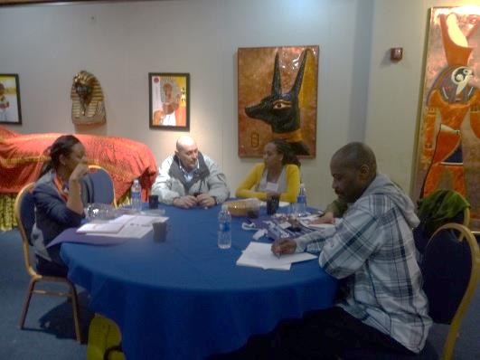
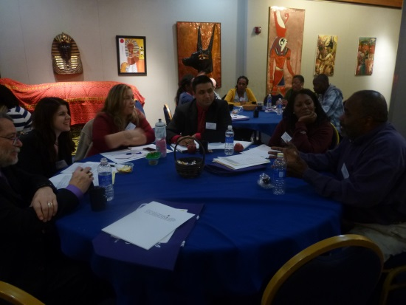
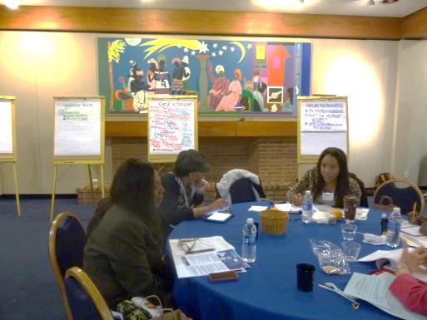
HBCU CAMPUS DIALOGUE
OBJECTIVE
Participants were tasked with crafting prevention and intervention paradigms that could resonate within a university environment.
FORMAT
Day 1: Faculty and Staff
Day 2: Undergraduate and Graduate Students
Notes:
Ray

Slide 11
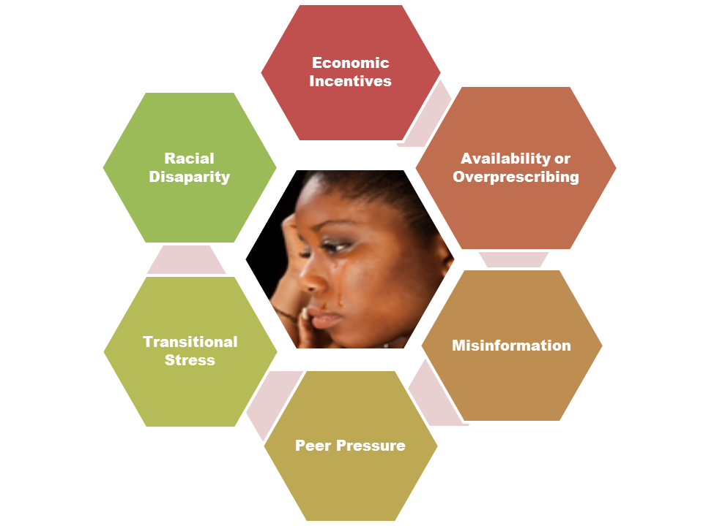
Dialogue findings
Cycle of Influence
Notes:
Ray w/ Ashley adding info.
Economic Incentives: Young adults are keenly aware of our country’s poor financial conditions, due to people losing their jobs. Daily reports of youth unemployment where young people are unable to secure positions are common. “It feels like they’re going backwards, and they can’t get their lives moving.”
Availability or Overprescribing: Fired by the belief and ultimate practice of, “We’ll give you something to fix you, and we’ll fix you from the inside out.” It’s the time of the quick fix – that medicine solves it all. Student’s don’t have time to consider stress-reducing strategies, they want answers now and drugs are considered an easy, quick answer. The reality is that these medicines are effective, and students know this. Students and faculty believed that some docs believe in “quick fixes.” Some don’t even check the backgrounds of their patients. ADHD meds are of particular concern – the disorder is over-diagnosed, the students concurred.
Misinformation: The media plays a big role in providing misinformation, faculty, staff, and students agreed. The integration of images and words, portraying drug abuse as “big fun” may normalize this behavior, giving students the mistaken impression that “everyone is doing it; why not try it; how could these medicines be so bad?” They see these images, and may be influenced to think that it’s abnormal to NOT drink or do drugs. And somehow, said Day One participants, “Kids have turned ‘bad into good.’”
IMPORTANT: Misinformation keeps students in the dark – students said: They may not be fully aware of the problems associated with misusing prescription medications because they believe that these medicines are safe. They don’t think about the consequences of their actions and consider taking medicines – even if they were not prescribed to them – as an option that one turns to in order to solve problems.
Peer Pressure: Internal pressure to conform. “When students find themselves at parties, and everyone is getting high, some may think that they are outside of the loop if they are not using,” affirmed a Day One participant. Students mimic their parents’ behaviors.
IMPORTANT: “Peer group culture is similar to the behavior of a school of fish. When fish swim, they don’t necessarily feel the pressure to conform,” Acknowledged the Day One Facilitator. If students feel like “everyone is doing it – including their parents, then drug misuse and abuse could be considered the norm. students affirmed, “Sharing medications, for some is what you do with friends.” It is socially acceptable and is not considered abuse. People are also writing songs and stories and glorifying drug taking behaviors. “You’re being influenced by others,” concluded the students.
Transitional Stress: THE BIGGY!
A culture that ignores addiction.
Sense of isolation – students are on their own when they reach campus.
Stress related to transitioning from home to independence.
College is supposed to form a “protective dome” over students, but it does not effectively do so.
Fear of the unknown.
Saying, “no” to drugs marginalizes students.
Lack of treatment and recovery assistance.
Racial Disparity: Drug abuse and addiction is a problem that is not discussed – taboo. “Families are closed about drug abuse and addiction, and there are perceptions of denial.”

Slide 12
Transforming the Cycle of Influence into Hope
“We need to push for transparency so we can work on mutual interests. There’s a lack of organization [about prescription drug abuse and related issues] on campus – is there some way to come together and address these challenges?”
Day Two, Student Participant
HBCU Campus Dialogue on Prescription Drug Abuse
1. Identify system challenges.
2. Shift the viewpoint.
3. Articulate provocative possibilities – what would change look like in five years or ten years?
4. Identify strategies to get there.
5. Create prototypes at the micro level.
6. Exploit conditions to viralize change.
Notes:
Ray

Slide 13
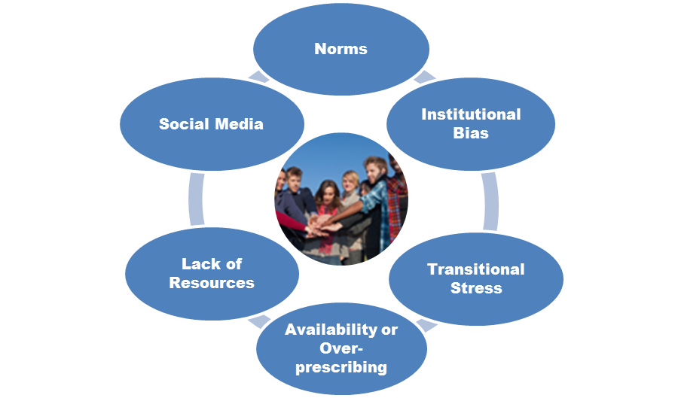
Agents for Change
Notes:
Ray and Ashley

Slide 14

Norms…
Selected Actions
Challenges
Include prescription drug abuse prevention as part of a university’s course offerings.
Create freshmen orientation programs that are meaningful and engaging.
Engage the community’s cultural brokers as spokespersons.
Reconnect with tradition.
Dedicate money for research: In addition to spending funds on testing medications, expand the research to include testing alternative medicines.
No meaningful responses to address this problem other than punitive actions.
RAs, who are ideally positioned to help students with the transition to college, aren’t prepared.
Freshmen orientation is essentially useless for addressing Rx abuse issues.
No one knows how to talk about their problems until the problems reach crisis proportions.
Notes:
Ashley
Immediate Actions
Include prescription drug abuse prevention as part of a university’s course offerings: Define abuse as building blocks – how it starts when it does not look like abuse and then progresses to the point where one needs medications to function.
Create freshmen orientation programs that are meaningful and engaging: Structured like retreats, these programs should give students the opportunity to acknowledge the power that they have in their lives – that students have the ability to make educated, informed and healthy decisions. Give students the tools to feel comfortable talking about hot button issues so if challenges arise, they know they don’t have to keep the problems hidden.
Long-Term Actions
Engage the community’s cultural brokers : Community elders are treated with respect, and involving them provides an anchor for students who may be missing that personal connection. Integrate the tradition of storytelling into teaching and mentoring.
Reconnect with tradition: Support the use of complementary and alternative health practices and medications.
Dedicate money for research: In addition to spending funds on testing medications, expand the research to include testing alternative medicines.

Slide 15

Institutional bias
Challenges
Selected actions
Faculty and staff put on blinders regarding the stress that students experience.
There is a lot of red tape and bureaucracy.
The university’s response to failing students is too punitive.
Not enough faculty support in helping students achieve.
Institutional bias can leave students feeling angry and isolated.
Set up dialogues between faculty/staff and students that open the lines of communication.
Create peer support for incoming freshmen.
Support collaboration across the university to address student academic failure, and develop strategies that support student success.
Create and/or strengthen the protocols that track failing students.
Craft holistic, sensitive responses to address academic failure.
Notes:
Ashley
Challenges Expanded:
Students believe that they have too much homework and competing priorities, and there is not enough support to help them negotiate through these challenges.
It is easier to blame the student rather than the institution – fix the student, not the system. If universities have an interest in students succeeding – which they do – provide more services, not sanctioning.
Institutional red tape, punitive reactions – in short, institutional bias – makes students angry and stressed out which can make students vulnerable to alcohol and other drug abuse.
Actions Expanded:
Immediate Actions
Set up dialogues between faculty/staff and students that open the lines of communication: Create and implement dialogues between students and university personnel, addressing the issues that make life on campus challenging. Topics include how best to prepare for exams; how to deal with transitions from home to school; how to apply for that first internship; and coping with life after graduation.
Create peer support for incoming freshmen: Develop credit-bearing opportunities for upper classmen to mentor freshmen. The activities should address the challenges that freshmen face as they transition to life void of parental influences.
Long-Term Actions
Support collaboration across the university to address student academic failure, and develop strategies that support student success: Identify the factors that are contributing to academic failure and determine where and how “the levers of change” can be moved.
Create and/or strengthen the protocols that track failing students: Notice the subtle changes in student behavior, i.e., drop in class attendance, drop in grades and lack of class participation. Develop/strengthen strategies to help students get re-focused and energized. Offer more supportive and targeted, on-campus services, and promote their use through the university’s communication mechanisms.
Craft holistic, sensitive responses to address academic failure: Bring the challenge of academic failure into the light; help students, staff and faculty to move beyond the stigma associated with failure; and change the paradigm of “getting help” from something negative to a positive.

Slide 16

Transitional stress
Selected actions
Challenges
Monthly life seminars for ALL students.
Senior seminar that addresses transition into adulthood.
Ongoing and comprehensive RA training.
Mentoring opportunities.
Online de-stressor chat rooms and groups
Campus-wide “unplugged day.”
Offer a wide variety of exam-taking options.
No internal resources to cope with the changes they’re experiencing.
Lack family support.
Lack of confidentiality on campus.
For students, Freshmen Orientations isn’t enough.
Lack of connection between professors and students.
Notes:
Ashley/ayana
Once again – the BIGGY!
Lots of immediate and long-term actions here – in fact, most of the recommendations addressed this hot-button issue. Here are some textual highlights:
Immediate Actions
Implement monthly life seminars for all students: These seminars would be designed to help students identify and navigate the typical challenges they will experience on campus – including:
Stress of transitioning from high school to college and from college to living in the real world.
Applying and getting into your college of choice, obtaining financial aid and “living the dream.”
Adjustment to dorm life – new friends, new culture.
Freedom away from home.
Peer pressure – use of drugs and alcohol as a strategy to handle stress.
Academic versus peer influences.
Unusual schedules.
How to deal with free time.
Loneliness.
The relationship between embracing stress on the college campus and how to cope with the stress of the real world after graduation.
These seminars should not be held in a classroom, but in comfortable, non-threatening locations. Freshmen, in particular, should be given incentives to participate; and seniors/upperclassmen should facilitate these programs and be given academic credit for taking on this responsibility. Perhaps this could be considered a course offering/internship for counseling, psychology, pharmacy or social work majors. The entire university should be on-board with these seminars – faculty, staff, administrators and student organizations – such as fraternities, sororities and academic clubs.
Create a senior seminar that addresses transitional issues: This class would introduce strategies and tools on how to more easily embrace post-graduation challenges.
Provide ongoing and comprehensive Resident Advisor training that includes:
Enhanced protocols on how to address students in crisis.
How to identify stress points and using stress as a motivator for positive change.
How to become a mediator.
Access to resources if students under their charge require assistance.
How to create and maintain mini-communities or families, built on the premise of trust.
Comprehensive training on the signs and symptoms of prescription and other drug abuse.
Create a mentoring structure and guidelines that ensure student support throughout the academic year – additionally, mentors should go out into the community to educate teenagers about the power to remain drug-free and to become critical thinkers about what they see and hear.
Develop and implement summer mentoring activities that introduce new students to life on campus.
Conduct weekly or biweekly meetings between mentors and their students.
Provide regular and consistent mentor training.
Honor the power of recovery by creating dialogues and forums that allow young people in recovery to talk about their experience: Presentations and discussions could be integrated into seminars, RA training and other appropriate venues.
Institute a campus-wide, “Unplugged” day at the beginning and end of the academic year: Encourage students to unplug from their electronics and create and implement activities where students are actively talking to each other.
Support the creation of support groups and interventions that address the needs of particular subgroups: Students should be treated as individuals, not numbers. Subgroups could include first generation college students, students from specific geographic areas, students new to campus life or students who grew up in transitional homes or the foster care system. RAs, mentors, staff and faculty need to be trained on how to work with students who have diverse and challenging personal histories.
Long-terms Actions
Support the creation of smaller professor/student class ratios: Faculty do not have the time to get to know their students because the class sizes are so large – how can it be expected, for example, for a faculty member to get to know 100 students in one class, multiplied by three or even four classes?
Safeguard your students’ confidentiality: Ensure that the university maintains consistent confidentiality guidelines and practices in all programs, including academic departments, residential life, the Greek system, student affairs, the career center and the health center.
Encourage universities to consider freshmen curfews: While this practice may initially appear to be punitive, the students felt that some freshmen would benefit from having clear guidelines in regards to when they should be back in the dorms.
Explore exam-taking options that relieve student stress: Perhaps schools could experiment with giving students the option of when to take final exams. For example, rather than forcing all students to take exams after the winter break, why not experiment and give students the option to take them before or after the break?

Slide 17

Availability or overprescribing
Challenges
Selected Actions
Doctors are not getting to know their patients, and are prescribing meds rather than pursuing alternative approaches.
Medicines are too easily accessible.
Abuse of Adderall is a problem.
Students don’t see their medicine-taking behaviors as “Abuse.”
Don’t have a comprehensive understanding of how students are misusing and abusing meds.
Support educating healthcare professionals about the problems associated with over-prescribing.
Create a two-minute video that accurately depicts the realities of overprescribing, and require its viewing!
Encourage the development of student, staff and faculty seminars on Adderall abuse:
Notes:
Ray/ashley
Stimulants A BIG ISSUE WHEN IT COMES TO OVERPRESCRIBING!
Immediate Actions
Educate students about the dangers of misusing prescription medicines: Raise student awareness, i.e., just because some medications are easily accessible, it doesn’t mean that they should be taken without a doctor’s prescription and guidance.
Support educating healthcare professionals about the problems associated with over-prescribing: Doctors and other prescribers may not be totally aware that their actions can result in the misuse and abuse of certain medications. Example: they need to appreciate that someone being prescribed pain medication for wisdom teeth extractions doesn’t necessarily need 20 doses of Oxycodone – when six would be sufficient. Train doctors to ask the “right questions” about the abuse potential of certain medications.
Create a two-minute video that accurately depicts the realities of overprescribing: Make the video required viewing for students and prescribers. This would be in addition to, or replace the prescription drug facts sheets that we receive when we pick up prescriptions.
Long-Term Actions
Commit research dollars to gaining a better understanding of the intersection between medicine compliance and abuse, paying particular attention to stimulants, pain medicines and other medications: We need to gain a better understanding of how young people are obtaining these medicines, what motivates providers to prescribe them and how to more effectively address their abuse potential.
Encourage the development of student, staff and faculty seminars on stimulant abuse: Raise the level of awareness about this problem, and support alternative approaches that address the symptoms that stimulants are designed to treat.

Slide 18
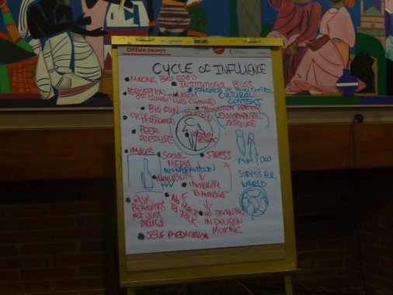
Lack of Resources
Selected actions
Challenges
Consistent and regular promotion of resources, using positive messaging.
Counseling center as a go-to alternative.
Support that’s available at “all hours.”
An app that notifies students of alcohol-free alternatives, and monitors stress levels and signs of depression.
Parents and guardians dialogues.
Universal screening for all students
Designated safe havens.
Health and Wellness Committee that solidly supported by Campus administrators.
Lack of awareness about on- and off-campus resources.
Absence of treatment availability.
Students aren’t engaged in creating solutions.
Some students will never seek help – how can we reach these students?
Notes:
Ray/AYANA
THIS WAS A BIGGY, TOO – SECOND TO ADDRESSING TRANSITIONAL STRESS. Here are some textual highlights.
Immediate Actions
Consistently and regularly promote the use of available resources to students, ensuring that the message, “we’re here to make this a wonderful experience,” is heard: The more students hear about services, the more they will integrate this information into their psyches. Incorporate messaging during new student orientation tours where guides can talk about where and what type of assistance is available. Students may even seek out assistance earlier as a result of this knowledge.
Engage the counseling center to provide training on key issues: The counseling center should be considered a safe place for students to come. The counseling center should be encouraged to conduct regularly-scheduled sessions about the stresses of college life; hold training programs for student mentors and RAs; become part of the “go-to” team when designing activities for transfer and freshmen students; and conduct a social media campaign that addresses transition issues.
Offer a wider variety of time that support is available and accessible: Ensure that support services are available on the weekends and at night – not just 9:00 am – 5:00 pm, Monday-Friday.
Create a solid, “dome of support” for students that includes on- and off campus resources. i.e.,
Assessing current resources, identifying the gaps and addressing how these gaps could be mitigated.
Building networks of support among colleges, faculty and staff to more effectively and consistently address student needs.
Promoting alternative approaches to healthy living: Activities could include scheduling regular check-ins with an RA or mentor regarding health issues; promoting stress-reducing activities such as yoga, kick-boxing and Zumba; and organizing and publicizing potluck dinners that promote healthy eating.
Identifying and establishing partnerships with community resources.
Create an app that notifies students of alcohol-and drug-free alternatives for the night, as well as monitors stress levels and signs of depression, addiction and other risk factors: Construct a competition among schools, asking competitors to build a prototype. Applicants would receive funding to build it, and the winning institution(s) would test it. In addition to offering healthy alternatives, the app could incorporate skype or video chatting so there would be a bridge between the app and the real world. The underlying message of the app would be to reach out to caring adults and peers before stress and other issues becomes overwhelming. Once tested, the task would be how to effectively market the tool beyond participating colleges and universities.
Engage parents and guardians in dialogues about at-risk issues and the resources that are available on campus to address them. Such activities may begin when students are accepted into school:
Disseminate information to parents and caregivers about available services.
Create and conduct online and telephone webinars.
Convene discussions during freshmen orientation.
Build a listserv that addresses parental concerns, and create ways in which parents can be kept abreast of on-campus prevention, intervention, treatment and recovery activities.
Long-Term Actions
Devote research dollars to studying the success rate of young people-led prevention and intervention strategies, and begin integrating these or similar programs on your campus: Young People in Recovery (www.youngpeopleinrecovery.org) and the Generation Rx Initiative (http://www.pharmacy.ohio-state.edu/outreach/generation-rx-initiative).
Consider incorporating universal screening for all students: Perhaps integrating screening protocols such as Screening and Brief Intervention and Referral (SBIRT) for all students living in the dorms, for example, may help identify problems before they occur.
Support the establishment of sober living dorms: These alcohol-free dormitories would not condone any alcohol or drug use and might also include specialized services for those in treatment or recovery from substance abuse addiction.
Designate safe havens for people on campus: “People don’t want to go to the counseling center because of the stigma associated with going there.” Safe havens should be conducive to sitting, listening and learning. It should be open to faculty, students and staff.
Create or strengthen a student health advisory board, and connect activities with similar, student-run activities: Such an entity is mission-critical so the administration can accurately advocate and address student needs. Likewise, having students represented on the board helps to ensure that student concerns will be heard. “Student involvement is important, and people will be interested if they’re pro-actively engaged,” affirmed Dialogue participants.
Create a new position – the Dean of Wellness – that would help support pro-health messaging on campus: This office, which could be inserted into an existing infrastructure, symbolizes the university’s commitment to drug-free lifestyles, celebrating transitions, full disclosure about drug and alcohol abuse and students supporting students.
Instill a philosophy on campus that the university has the resources that students need to emotionally succeed in school: Regularly examine and review available services that come in contact with students – the counseling center, career center, health center, residential life and student associations – to confirm that they are consistently meeting student needs, and if they are not, make the necessary changes to ensure that services resonate with students. Promote all of these services on your website, in your correspondence with new families, on-campus during freshmen orientations and throughout the year.
Provide additional financial support to prevention, treatment and recovery programs: Help ensure that students who can’t afford to pay for services receive assistance for free.

Slide 19
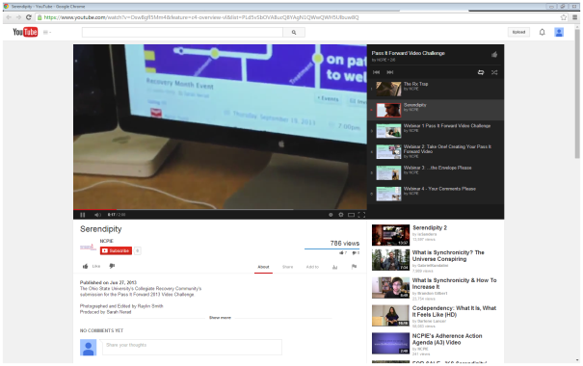
Social media
Selected actions
Challenges
Focus groups or informal discussions with students to confirm the methods and messaging they are receiving and sending about alcohol and other drugs.
Acknowledge the role that media plays in influencing drug and alcohol abuse.
Build opportunities where students and university staff and faculty can communicate with each other.
Social media is being used to promote drug-taking activities and behaviors, sending the wrong message – that drug taking is the norm.
What we see on TV and in the movies condones drug use.
The administration is powerless to stop these messages from being broadcast over the airwaves.
Notes:
Ayana

Slide 20

Why we care…
How can we do a better job of creating connections between prescription drug abuse and the risk and protective factors that influence/protect students from abusing these medicines?
What parallels can we draw? Correlating issues and/or populations?
How can YOU bring some of these issues and recommendations to light on your campus?

Slide 21
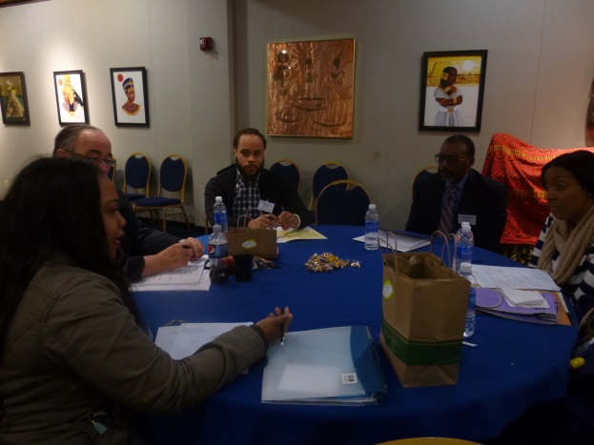
Let’s talk about it!
Notes:
Ashley’s slide!
This slide is very important – why should you care?
We want you start thinking about people of other cultures can be affected by this problem.
Bring it full-circle.
Cultural Competency – if you become more culturally competent, you can do a better job of serving a wider and broader audience.

Slide 22
Thanks for Participating
To learn more….
Ray Bullman
National Council on Patient Information and Education
301.340.3940
bullman@ncpie.org
www.talkaboutrx.org

