Slide 1
SAMHSA’s
TCU Behavioral Health Summit
Prescription Drug Abuse in Indian Country
Friday, February 12, 2016
11:30 am – 12:30 pm
Notes:
RAY

Slide 2

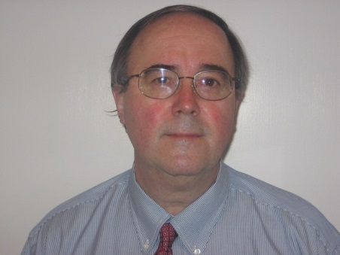
Your Presenters
Melissa Holder, PhD, Social Work Program, Haskell Indian Nations University
Ray Bullman, Executive Vice-President, National Council on Patient Information and Education
Notes:
RAY

Slide 3
Prescription Drug Abuse in Indian Country
This interactive session will:
Present known facts & influencers about prescription drug abuse in Indian Country
Seek participants' insights & vision – as campus leaders and leaders in their communities – about prescription drug abuse prevention, treatment, campus- and community-based recovery support.
Notes:
RAY

Slide 4
“We have long known that American Indian communities are particularly vulnerable to problems with substance use...But because national surveys fail to fully capture drug use patterns on or near reservations, the true scope of the problem has been elusive.”
Source: NIDA; Substance Use in American Indian Youth is Worse, Sept. 11, 2014
Notes:
RAY

Slide 5
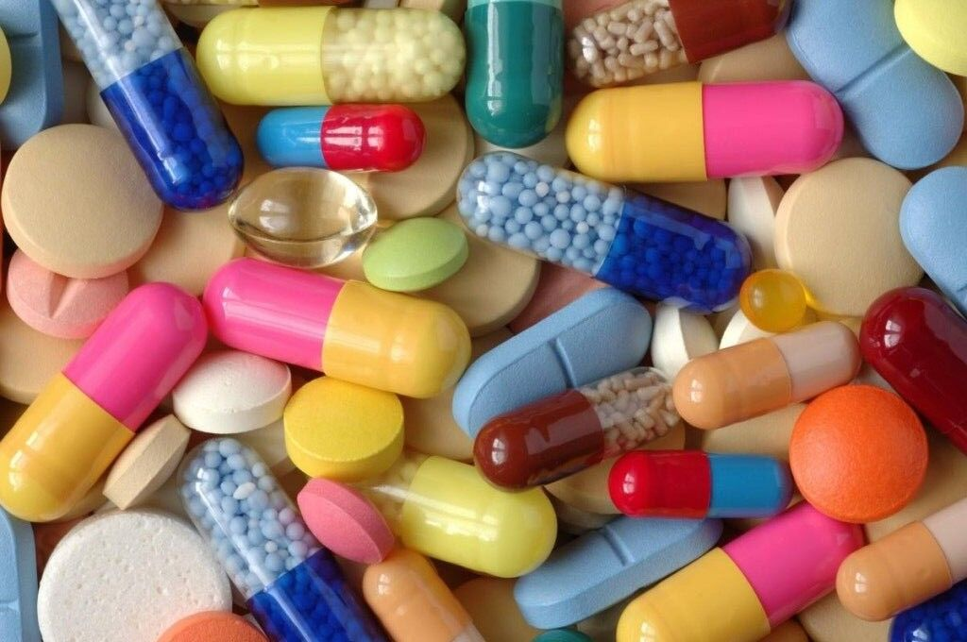
What we know…
The rate of drug-related deaths among American Indian and Alaska Native people is almost twice that of the general population.
Drug-related deaths among American Indians and Alaska Natives increased from five per 100,000 population (adjusted) in 1989-1991 to 22.7 per 100,000 in 2007-2009.
The rates of death from prescription opioid overdose among American Indians or Alaska Natives increased almost four-fold from 1.3 per 100,000 in 1999 to 5.1 per 100,000 in 2013 (Centers for Disease Control and Prevention (CDC)
Opioid painkillers, such as oxycodone, hydrocodone and hydromorphone, are responsible for three-fourths of all prescription-drug-overdose deaths.
Sources: New Effort Targets Drug Overdoses in Indian Country, Native News Online.Net & TulsaWorld.com’s Agreement announced in trying to curb drug overdoses in Indian Country
Notes:
RAY

Slide 6
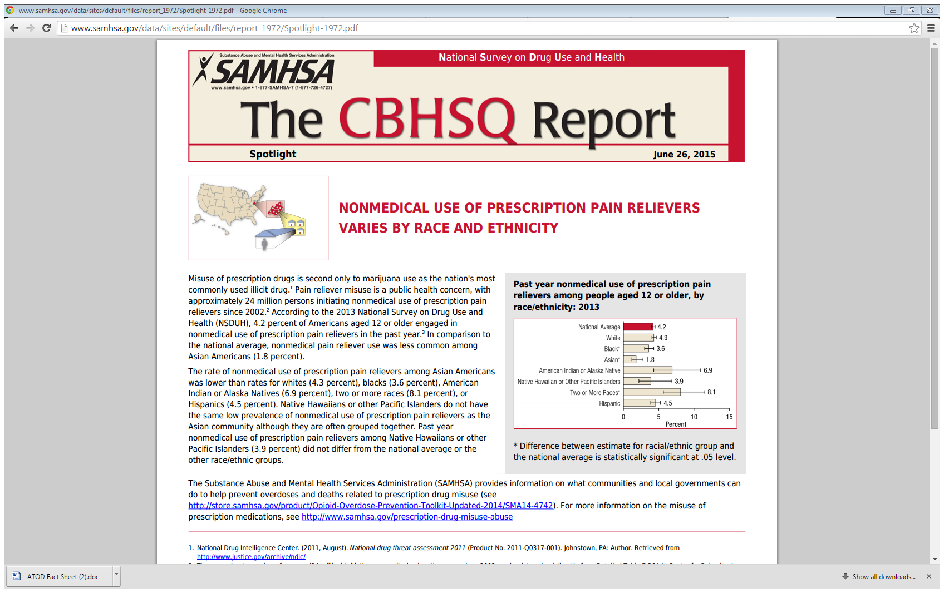
Another Look at the Data…
Misuse of prescription drugs is second only to marijuana use as the nation's most commonly used illicit drug. Pain reliever misuse is a public health concern, with approximately 24 million people initiating nonmedical use of prescription pain relievers since 2002. According to the 2013 National Survey on Drug Use and Health (NSDUH), 4.2% of Americans aged 12 or older engaged in nonmedical use of prescription pain relievers in the past year, compared to 6.9% of American Indians and Alaska Natives.
Source: Nonmedical use of prescription pain relievers varies by race and ethnicity, SAMHSA – The CBHSQ Report, June 26, 2015

Slide 7
Prescription Drug Use among American Indian & Alaska Native Youth
Higher prevalence of drug and alcohol use in 8th and 10th graders compared to national averages:
American Indian (AI) students’ annual heroin and Oxycontin use: Two to three times higher than the national averages for 8th and 10th graders.
Among AI 8th graders:
OxyContin: 6.3%
Tranquilizers: 3.6%
Use of narcotics other than heroin: 10.4% (codeine, methadone, morphine)
Source: University of Colorado’s Tri-Ethnic Center’s Substance abuse among American Indian students compared to national rates 2009-2012
Notes:
The University of CO analyzed data from the American Drug and Alcohol Survey given to American Indian students at 33 schools on or near reservations in 11 U.S. states in 2009-2012.
A comparison with nationwide data from the Monitoring the Future (MTF) survey was striking, particularly regarding the much higher prevalence of drug and alcohol use in 8th and 10th graders compared to national averages.
The study showed that adolescent substance use is still a major problem among reservation-based AI students. In many cases, the differences were quite dramatic.

Slide 8

Interventions
Infuse prevention, intervention and recovery strategies EARLY and OFTEN.
Support “connectedness as culturally-based protective factor against substance abuse and suicide.”
Blend traditional and modern best practices across the spectrum of behavioral health and wellness promotion (healing circles, sweat lodges, and ceremonies).
Incorporate community-driven, culturally grounded prevention interventions, derived from the beliefs and values of a given tribe or culture.
Integrate the use of Naloxone to treat opioid and heroin overdoses.
Sources: NIDA’s Substance Use in American Indian Youth is Worse than We Thought, 25-2 Winter 2013: “Tribal and Behavioral Health” Resource Guide & TulsaWorld.com’s Agreement Announced in Trying to Curb Drug Overdoses in Indian Country
Notes:
RAY

Slide 9
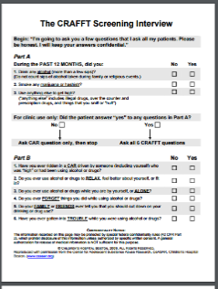
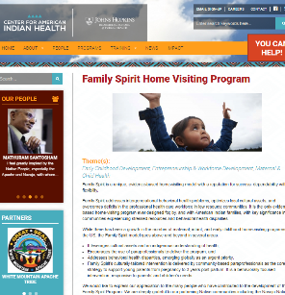
Intervention Gallery
 | Culturally-relevant screening tools, including the CRAFFT: A series of 6 questions developed to screen adolescents for higher risk alcohol and other drug use disorders. Source: Tribal College Journal of American Indian Higher Education’s 5-2 Winter 2013: “Tribal and Behavioral Health” Resource Guide
 | Family Spirit: Early prevention targeting American Indian teen mothers. It is the only evidence-based home-visiting program ever designed for, by and with American Indian families, with key significance in communities experiencing stressed resources and behavioral health disparities. Sources: Tribal College Journal of American Indian Higher Education’s 5-2 Winter 2013: “Tribal and Behavioral Health” Resource Guide & JHU’s Center for American Indian Health’s Family Spirit Home Visiting Program
Notes:
RAY
Small sampling of what’s available.

Slide 10
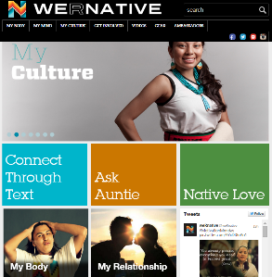

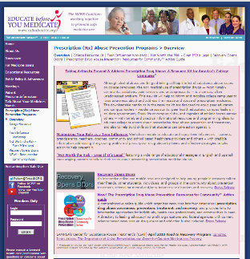
Intervention Gallery
 | WeRNative.org: a comprehensive health, web-based resource for Native youth, by Native youth, providing content and stories about the topics that matter most to them. Strives to promote holistic health and positive growth in local communities and the Indian Nation at large. Source: www.WeRNative.org
 | Affordable Care Act: The ACA covers essential services for everyone – children and adolescents included. Adolescents can receive depression screening, alcohol and drug abuse assessments and more for FREE if covered preventive services are received in the person’s provider network – including the Marketplace or Medicaid. Source: SAMHSA’s Prevention & Recovery Native Youth Today! Bridging the Gap
 | NCPIE’s Prescription Drug Abuse Prevention Suite of Resources: Resources targeting colleges and universities and the community include: www.recoveryopensdoors.org: Interactive website targeting young adults in recovery as they educate others about the power of recovery. Taking Action to Prevent & Address Prescription Drug Abuse: Downloadable Resource Kit for America's College Campuses. The Prescription Drug Abuse Prevention: Resources for Community Action™ guide: An "at-your-fingertips" online guide to resources on this critical health topic.
Notes:
RAY

Slide 11
Factors that Impact Youth Drug Abuse
WHAT DO YOU THINK?
Cultural dislocation / lack of integration into either traditional Indian or modern American life.
Lack of clear-cut sanctions against use among Native Americans because alcohol and drug use is considered “normative.”
Strong peer-group support for drug use.
Lack of hope for a bright future.
Circa 1991
Source: Moving towards a “just and vital culture” Multiculturalism in our Schools, 1991
Notes:
MELISSA: This was written in 1991. Do these factors still resonate today?
Discuss.

Slide 12

Think about it….
Are you seeing prescription drug abuse-related challenges on your campus and in your community?
If so, what are these issues?
What CAMPUS-BASED policies do you have in place to address prescription and other forms of drug abuse?
What CAMPUS-BASED programs do you have in place?
What COMMUNITY-BASED policies and programs are in place to address these challenges?
Notes:
MELISSA

Slide 13
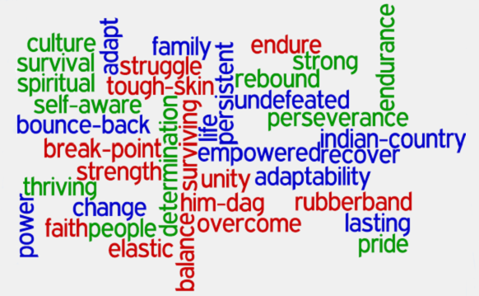
Think about it….
Are resources missing?
What additional actions will you take to address prescription and other forms of drug abuse on your campus and in your community?
Notes:
MELISSA

Slide 14

Thx & Learn more
Ray Bullman, NCPIE, bullman@ncpie.info
Follow: @TweetNCPIE
Like: facebook.com/ncpie
Melissa Holder, PhD, Haskell Indian Nations University, mholder@Haskell.edu
Notes:
RAY AND MELISSA

